Slide 1


TO STUDY SOCIO - ECONOMIC STATUS AND IMPACT OF DRUDGERY ON HEALTH OF FARMING WOMEN
Guided by:
Manisha Pandya
Shrey Pandya
Presented by:
Darpan Padaria
Vishal Harijan
Rajadip Chhasatiya
Dipak Bariya
Notes:
1

Slide 2
OUTLINE
INTRODUCTION
NEED FOR STUDY
OBJECTIVES
METHODOLGY
SAMPLING METHOD
ANALYSIS
REFERENCES
Notes:
2
2

Slide 3
INTRODUCTION
The rural women play a significant role in agriculture and other agro based activities. Also in agriculture, women are the major workers assigned the heavy drudgery work, such as weeding, harvesting, carrying head loads, etc.
Such work is often called “drudgery work”, which means dull and boring work, but it is also heavy work, back-breaking work, often dangerous work.
If appropriate drudgery reduction technologies are made available to the farmwomen at home and farm, it would definitely contribute in reducing their drudgery, increasing their working capability, increasing farm production resulting in improved quality of life.
Aatapi Seva Foundation strives to facilitate the holistic and sustainable development on socio-economic status, health of farming women and impact assessment of drudgery reduction tool through need based intervention voiced by the community.
Notes:
3
3

Slide 4
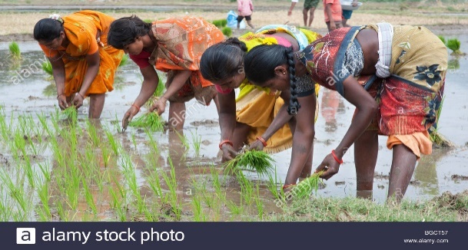
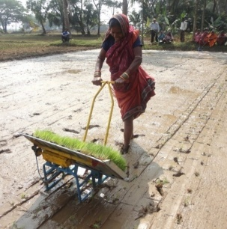
Need For Study
Activities like sowing, weeding, irrigation, harvesting, winnowing, etc. are mostly done by manually or by traditional tool.
All these factors results in physical and mental fatigue, monetary hardship, exploitation, pain etc. Various activities done by traditional methods takes long time to complete and this may results in mental tiredness .
By providing drudgery reduction tools these all problems can be solved or minimize the risk of women’s health.
So it is very necessary to first study the impact of different drudgery activities on women’s health.
And also this will improve rural women’s economic condition in long run.

Slide 5
OBJECTIVES
To study the relationship between different drudgery activity and their impact on women’s health.
To study the relationship of socio - economic status of farming and non- farming women.
Notes:
5
5

Slide 6
METHODOLOGY
Source of data:
Study will be based on primary data.
Target Population:
All women(farming and non farming) of Kareli and Samoj village of Jambusar taluka in Bharuch district.
Survey Design
- Primary data will be collected into two parts
i) By questionnaires
ii) By conducting medical camp at both the villages
Notes:
6
6

Slide 7

SAMPLING METHOD
Multi stage sample
Stage 1 : Simple Random Sampling
Stage 2 : Stratified Sampling
Stage 3 : Equal Proportion Allocation
STAGE 1 :
N = Total Population Size = N1 + N2 = 3429
α= 0.05
Z score = 1.96
Ɛ= Margin of error = 0.05
p = 0.8 = proportion of those people on which drudgery impact’s their health status
n = Total Sample size = 346
- Simple Random Sampling
$$n=\frac{NZ_{α/2}^{2}pq}{\left(N−1\right)Ɛ^{2}p^{2}+Z_{α/2}^{2}pq}$$

Slide 8
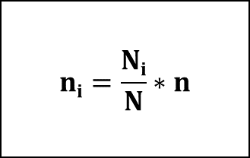
STAGE 2:
- By Stratified Proportional allocation
Population Size
Kareli (2712)
Samoj (717)
$$ni=\frac{Ni}{N}∗n$$
Total Sample size (346)
Kareli (274)
Samoj (72)
STAGE 3:
- By Equal Proportion allocation.
Farming (137)
Non-farming (137)
Farming (32)
Non-farming(32)

Slide 9
ANALYSIS
CLASSIFICATION
Category Scale
Upper Class >43
Upper Middle Class 33-42
Middle Class 24-32
Lower Middle Class 13-23
Lower Class <13
Udai Pareek Scale:
To find, socio-economic status of women
Drudgery Index: To decide drudgery load for various farming activities
Drudgery Index = [ (X+Y+Z)/3 ] *100
Where, X = Co-efficient of difficulty felt
Y = Co-efficient of time spent in particular farm activity
Z = Co-efficient of frequency of performance
.
Caste
Education
Occupation
Land
Social Participation
House Type
Farm Power
Material
Family Member

Slide 10
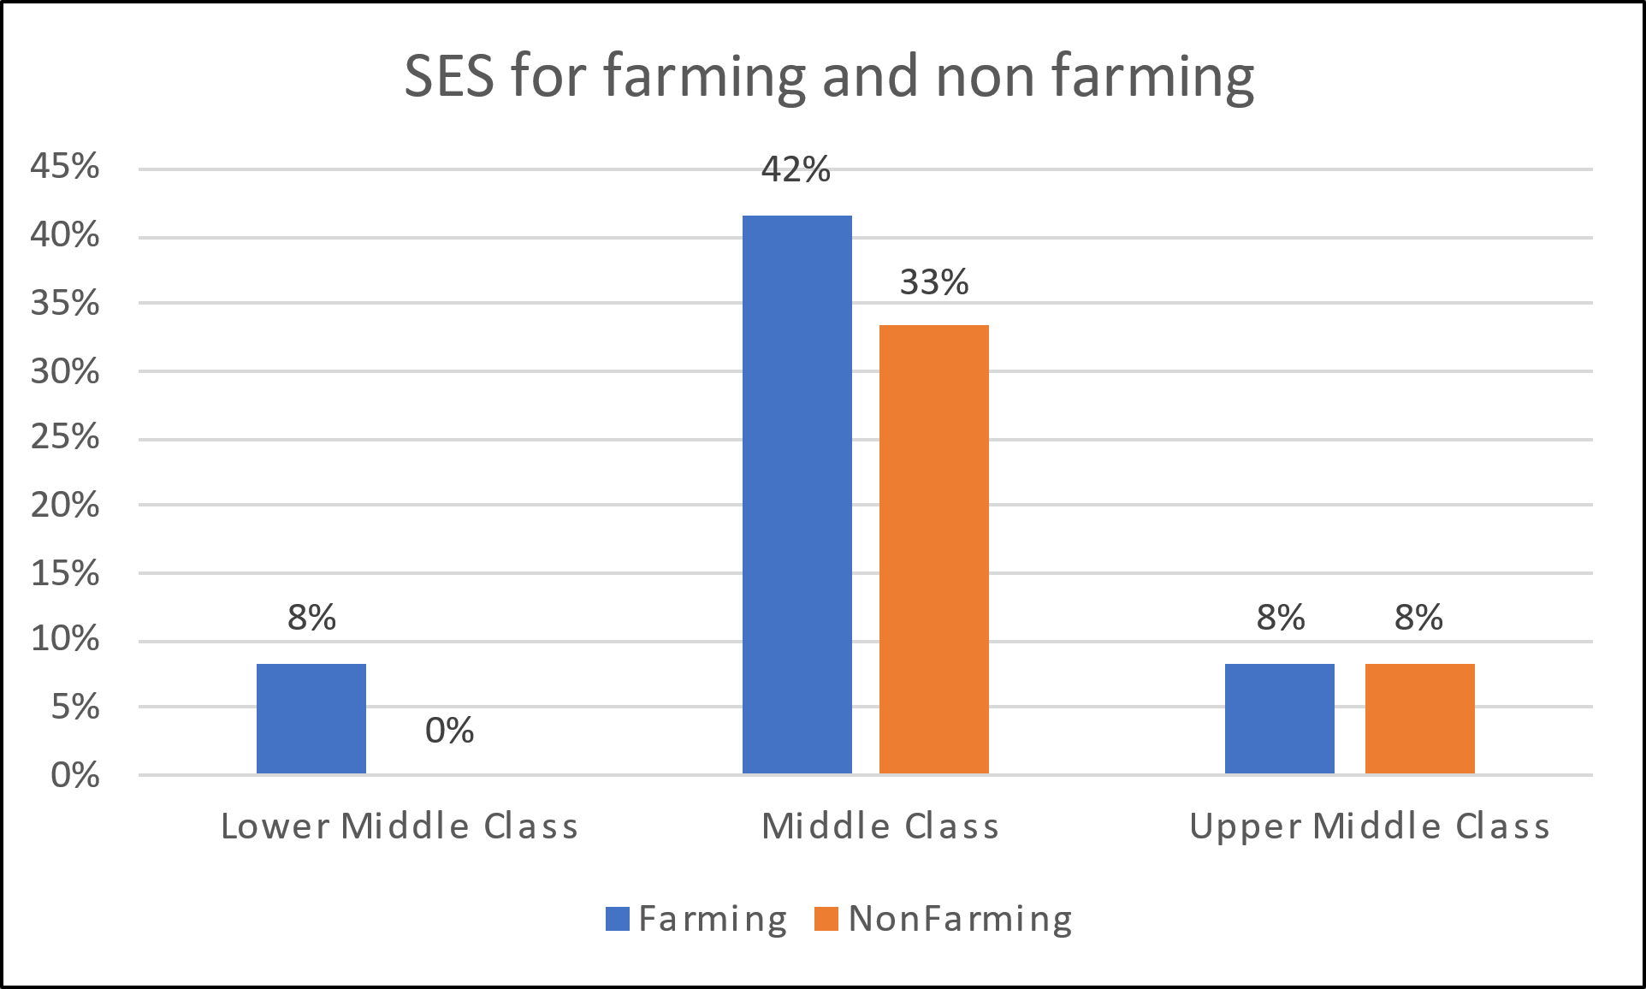
Graphical Visualisation of socio economic status of women and drudgery index based on pilot survey.
- Most of the family classifies in the range of Middle class.

Slide 11
-Cutting and Farm cleaning are the most drudgery prone activity.

Slide 12
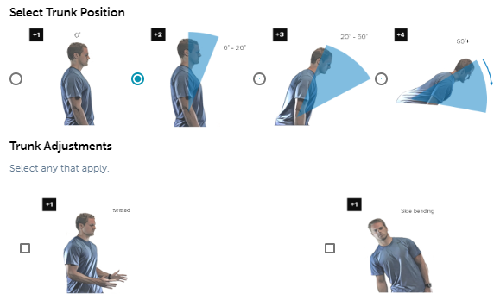
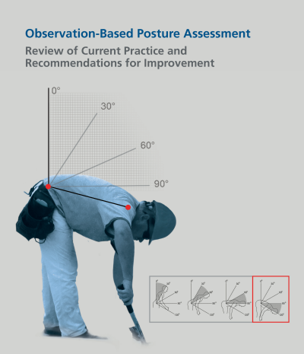
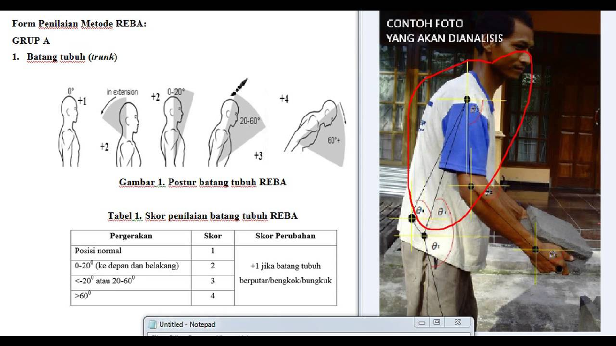
REBA and RULA :
REBA stands for Rapid Entire Body Assessment and
RULA stands for Rapid Upper Limb Assessment

Slide 13
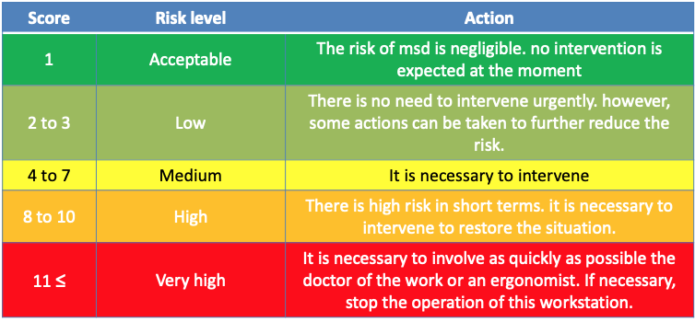
Scoring

Slide 14
STATISTICAL TOOLS
Exploratory analysis
Normality test
Correlation coefficient
ANOVA
Chi-square test
Multiple linear regression

Slide 15
REFERENCES
https://www.researchgate.net/publication/323147882_Impact_of_Drudgery_Reducing_Technologies_among_Farmwomen_of_Gorakhpur_and_Deoria_districts_of_U_P
https://www.researchgate.net/publication/337903792_Drudgery_reduction_for_women_in_agriculture_sector_in_Nepal_An_analytical_study
A Step-by-Step Guide Rapid Entire Body Assessment (REBA) (www.ergo-plus.com)
Research Article AWARENESS AND ADOPTION OF DRUDGERY REDUCING TECHNOLOGIES AMONG FARM WOMEN OF DANTIWADA TALUKA (SUMITRA SUNDHESHA, AHLAWAT SANTOSH AND SINGH SURABHI)
A case study on women reducing drudgery through empowerment in agriculture in Dangs of Gujarat (G.J. BHIMANI AND C.S. DESAI)

Slide 16
THANK-YOU!
Notes:
16
16

